Slide 1
NTT DATA Response to <<Client and Project Name>>

Slide 2
The case for artificial intelligence in combating money laundering
Combating money laundering is an enormous task, and it comes with substantial costs and risks, including but not limited to regulatory, and financial crime risks.
“When financial institutions, regulators,enforcement agencies work together using new technologies and sharing intelligence and information, the entire ecosystem stands to benefit.
It is paramount that international cooperation is prioritised to anchor goals toward fighting financial crime and making an impact that matters in the face of rapid and fast-shifting criminal typologies.
As financial institutions and FinTech's increase the experimentation and use of AI and data analytics to improvetheir services, government agenciesneed to ensure that our support, policies and regulations are attuned to developments and remain supportive of
these new technologies

Slide 3
Artificial Intelligence & Machine Learning for Prevention of Money Laundering & Fraud Detection

Slide 4
Pain Points Of the Banking Sector
The Main Pain Points of the Banking sector are :-
Fraud Transaction
Money Laundering
Fraud Transactions :
Over 900 cases of fraud related to debit/credit cards and internet banking, involving amount of Rs 1 lakh and above, were registered during April-September 2018 . Reserve Bank of India (RBI) has registered a total of 921 cases of fraud involving ATM/debit cards, credit cards and Internet banking, wherein the amount involved was Rs 1 lakh and above, during 2018-19 (up to September 30, 2018) .
Money Laundering :

Slide 5
Pain Points Of the Banking Sector
Money Laundering :
The best banking system will be able to ensure good production in all sectors of the economy. Money laundering is the process of providing legitimate appearance to the illegally gained revenue. Money Laundering has the tradition of eroding the financial institutions and weakening the financial sectors’ role in economic growth. It has the habit of facilitating corruption, crime and other illegal activities at the expense of countries development and can increase the risk of macroeconomic instability.
Banks and other financial institutions are at the forefront of the battle against the money launderers. The negative economic effects of money laundering on economic development are difficult to quantify. International society expects every bank to perform customer identification and due diligence as it is the important control measure in preventing criminals from entering the legitimate economy. The cost involved in combating money laundering and terrorist financing transactions are increasing largely on yearly basis however unable to eradicate them.

Slide 6
Solution Overview For Anti Money Laundering & Fraud Transactions
Uses and potential applications of machine learning in fighting money laundering
Banks are therefore keen to leverage the rise in computing power to analyse large volumes of data assets and to “learn” from the results.
In the compliance realm, there is a real sense of opportunity where ML can assist in enhancing effectiveness, efficiency and accuracy of processes within a bank’s core money laundering and terrorist financing risks detection and reporting system.
For Example :
ML algorithms can be taught to detect and to recognise suspicious behaviour and risk rate them accordingly.
Combining outputs of existing systems, ML models can be trained to identify the behavioral characteristics or indicators that highlight when activity is truly suspicious.
ML can be applied to name screening.
Applying ML to improve the matching criteria as well as predicting the likelihoodof a name match

Slide 7
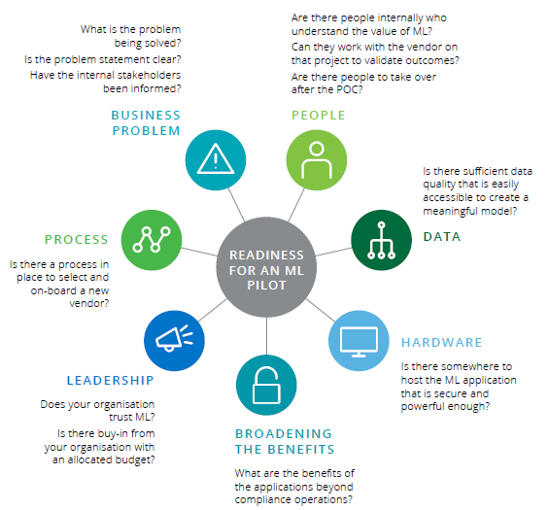
Solution Design By using ML

Slide 8
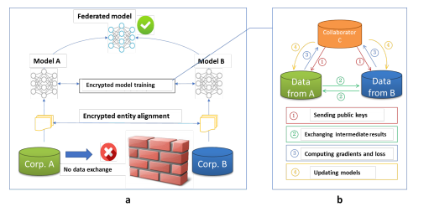
Federated Machine Learning

Slide 9
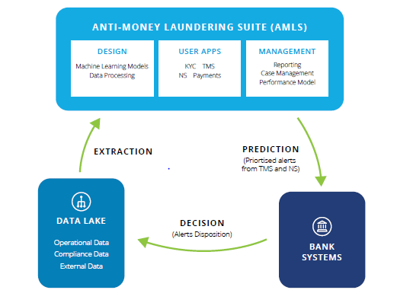
Anti Money Laundering Suite

Slide 10
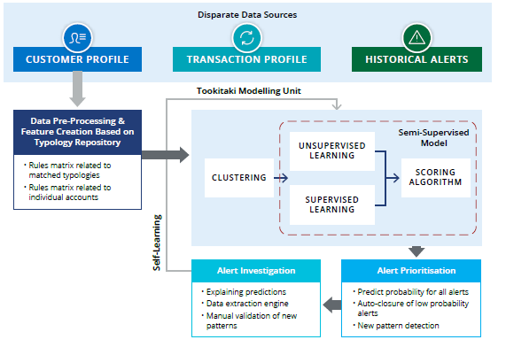
Applying Machine Learning To alert Prioritization

Slide 11
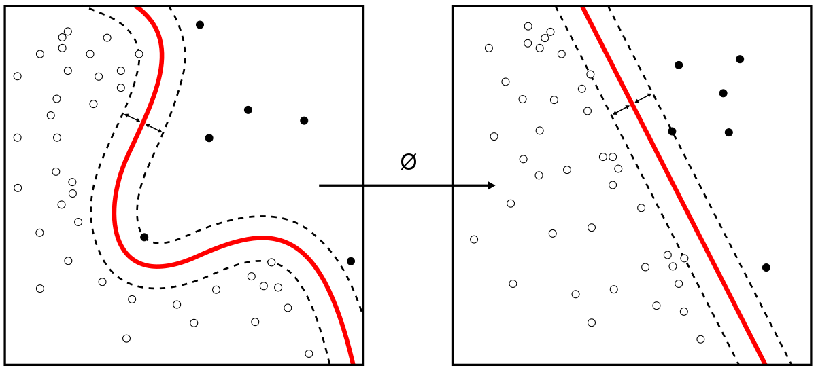
Fraud Detection Using ML

Slide 12
7. Client References

Slide 13
8. Training Information

Slide 14
9. Assumptions

Slide 15
10. Pricing
Pricing Overview
Pricing Assumptions

Slide 16
Appendix 1: Resumes

